Slide 1
TYPES OF COMPUTER
PRESENTED BY S.R.Zameer

Slide 2
4 DIFFERENT TYPES OF COMPUTER
Performance
Power
Size

Slide 3
SUPERCOMPUTERS
MAINFRAME COMPUTERS
MINI COMPUTERS
MICROCOMPUTERS

Slide 4
SUPERCOMPUTERS
very expensive
very fast
most powerful computers

Slide 5
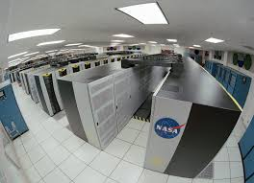

Slide 6
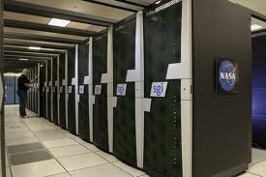

Slide 7
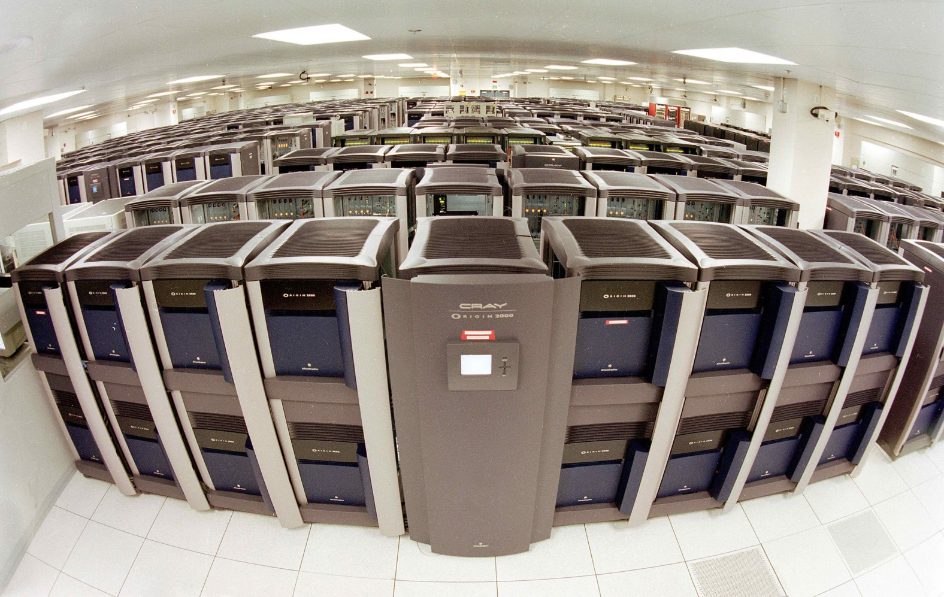

Slide 8
MAINFRAME COMPUTERS
large and expensive computer
mostly used by governments and large organizations for bulk data processing
ranked below supercomputers

Slide 9
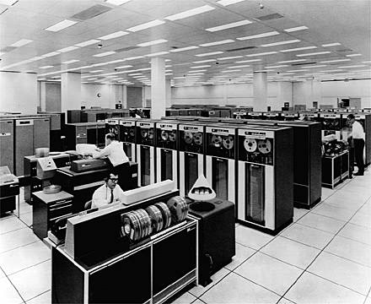

Slide 10
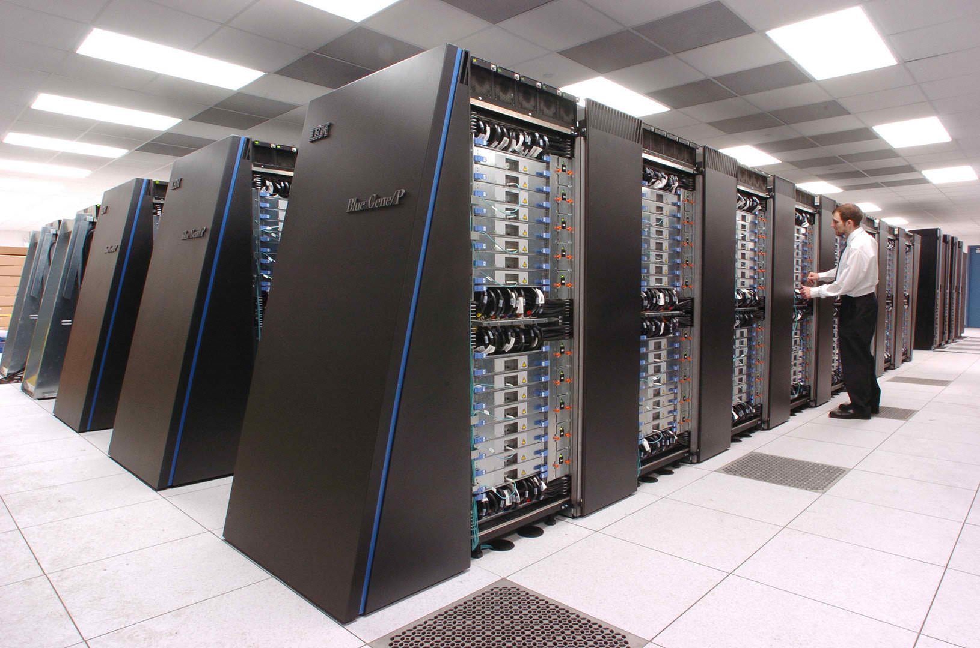

Slide 11
MINICOMPUTERS
midsized computers
a multiprocessing system
ranked below mainframes

Slide 12
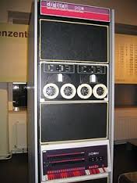
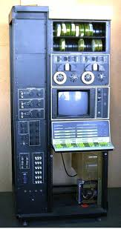

Slide 13
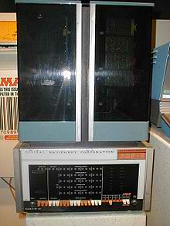

Slide 14
MICROCOMPUTERS
used by one user at a time
relates to microprocessor
most common computer types

Slide 15
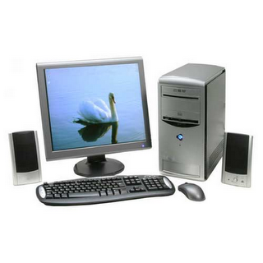

Slide 16
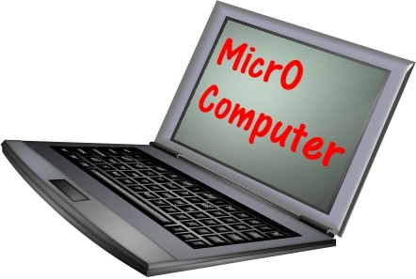

Slide 17
MICROCOMPUTERS
Desktop
PERSONAL COMPUTERS
portable computers

Slide 18
DESKTOP PCS
not built to be mobile
large and heavy in comparison to portables
power supply is mandatory

Slide 19
DESKTOP PCS
Tower casing
Desktop casing

Slide 20
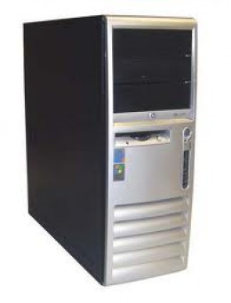
TOWER CASING
- the motherboard is placed on side of the system unit

Slide 21
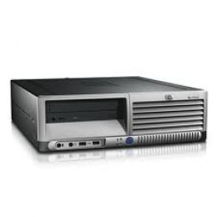
Desktop casing
- the motherboard lies on the bottom and is parallel to the desk or table

Slide 22
PORTABLE COMPUTERS
designed for mobility
small, compact and light in weight
have their own power in form of a battery

Slide 23
PORTABLE COMPUTERS
Laptop
PDA
Handheld Computer
Tablet PC

Slide 24
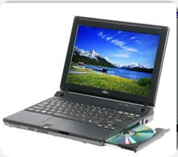
LAPTOP

Slide 25
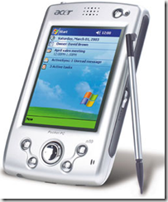
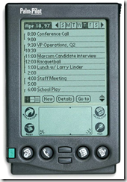
PDA

Slide 26
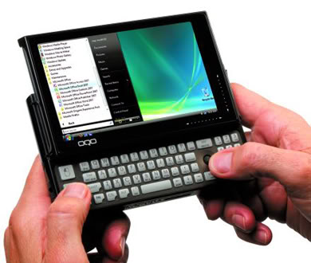
HAND HELD COMPUTER

Slide 27
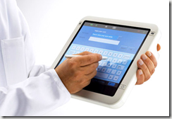
TABLET PC

